Slide 1
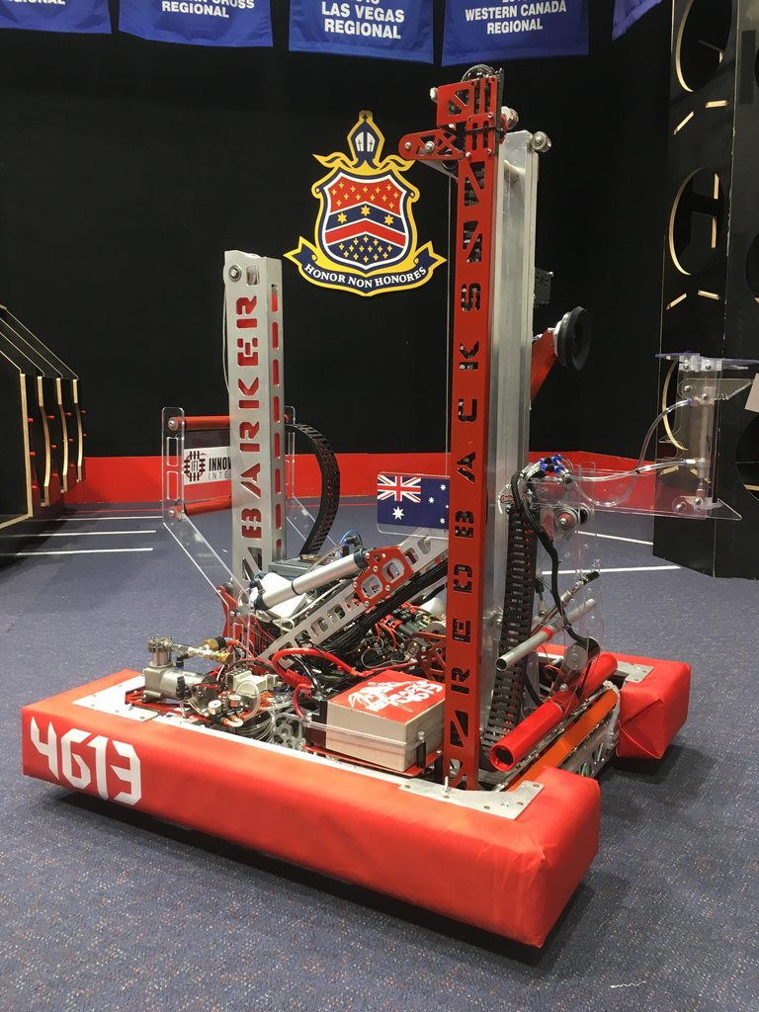

Repetition
Overall Topic: Hardware
Basic Workshop 1.5

Slide 2

Introduction to repetition
What is repetition?
Running the same code multiple times
Why?
To perform some operations on all of a collection of items
To repeat a process e.g. Check controller inputs and update instructions to robot

Slide 3

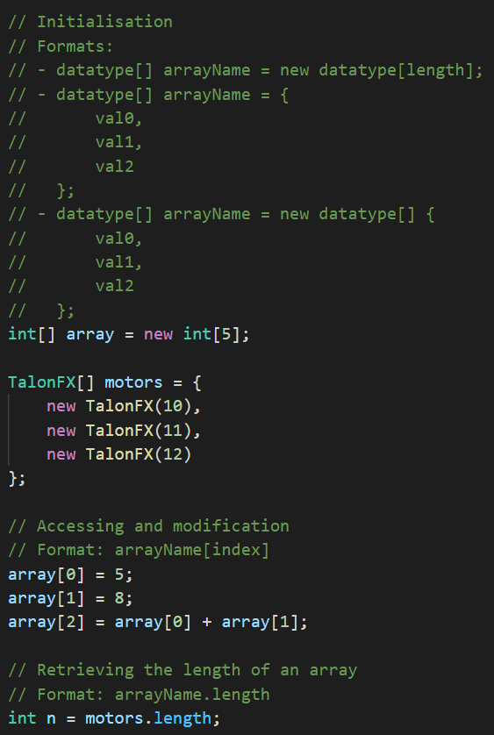
Arrays
What is an array?
A complex type of variable
That stores a list of values
Numbered from 0 to (length – 1)
Of a fixed type
With a fixed length

Slide 4

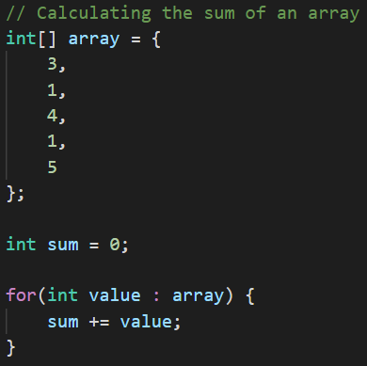
The for-each loop
The for-each loop
Runs the code inside its braces once for each value in an array
Creates a temporary variable to store the current value from the array
for(datatype tempName : arrayName) {…}

Slide 5
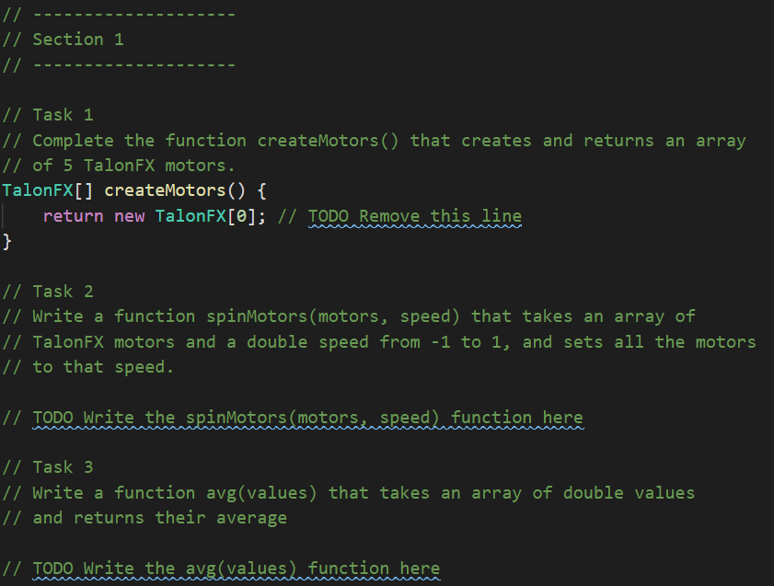
Your turn
Complete section 1 of the Tasks file for this week’s folder.
Remember to update your repository with “git fetch” and “git pull” from Git Bash.

Slide 6
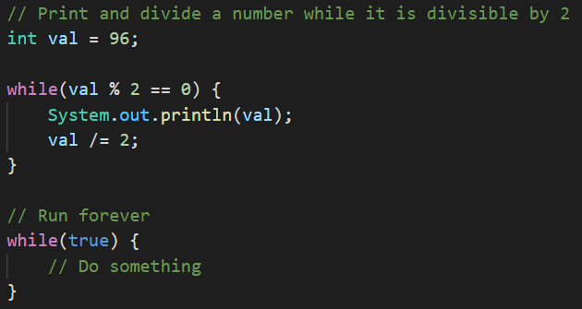
The while loop
The while loop
Is similar in structure to an if-statement
Runs the code inside its braces until its condition is false
while(condition) {…}

Slide 7
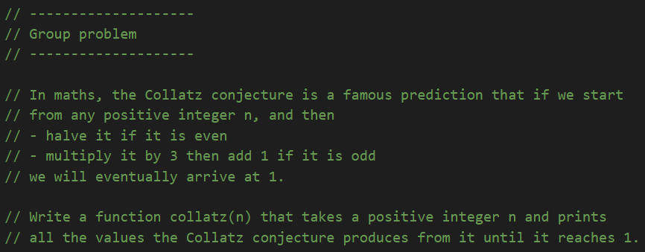
A group problem
We can use while loops for various problems that don’t require arrays.

Slide 8
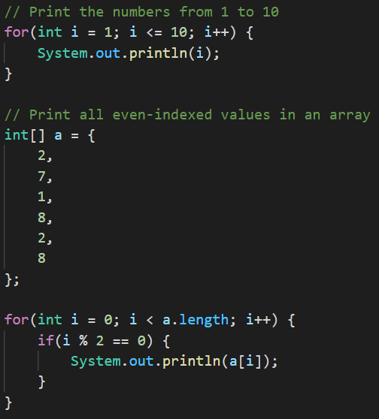
The for loop
The for loop is similar to a while loop, with 3 parts
The initialiser is a line of code that runs before the first loop
The condition determines whether the loop should run
The incrementer runs after each loop
for(initialiser; condition; incrementer) {…}

Slide 9
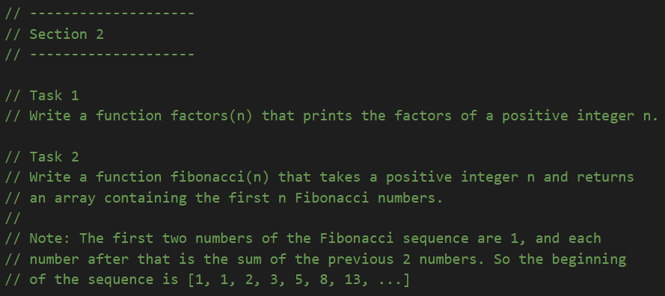
Your turn
Complete section 2 of the Tasks file for this week’s folder.

